Slide 1
Lecture 7 :
Equivalence between NFA and DFA
Agenda
How to convert NFA-DFA?
Theorem :For an every NFA there is an equivalent DFA
Method 1: Subset Construction(E-Closure )(Indirect Method)
Method 2: Partition Method(Direct Method)
Presented by
Prof. Vaibhav Narayan Chunekar
K. J. Somaiya College off Engineering, Vidyavihar, Mumbai

Slide 2
Theorem :For an every NFA there is an equivalent DFA
Let language L ⊆ Σ*, and suppose L is accepted by NFA N = (Σ, Q, q₀, F, δ). There exists a
DFA D= (Σ, Q’, q’₀, F’, δ’) that also accepts L.
(L(N) = L(D)).

Slide 3
Equivalent Parameters of D and N:
Q’ is equal to the powerset of Q, Q’ = 2^{Q’}
q’₀ = {q₀}
F’ is the set of states in Q’ that contain any element of F, F’ = {q ∈ Q’|q ∩ F ≠ Ø}
δ’ is the transition function for D. δ’(q,a)=∪_{p∊q} δ(p,a)for q ∈ Q’ and a ∈ Σ.

Slide 4
Fundamentals DFA and NFA Terminology
Remember that each state in the set of states Q’ in D is a set of states itself from Q in N.
For each state p in state q in Q’ of D (p is a single state from Q), determine the transition δ(p,a).
δ(q,a) is the union of all δ(p,a).

Slide 5
Proof :L(D)=L(N)
Will prove δ’(q’₀,x)=δ’(q₀,x)
Basic Step
Induction Step

Slide 6
Basis Step
Let x be the empty string ε.
δ’(q’₀,x)= δ’(q’₀,∊)
δ’(q’₀,x)= q’₀
δ’(q’₀,x)= {q₀ }
δ’(q’₀,x)= δ’(q₀,∊)
δ’(q’₀,x)= δ’(q’₀,x)

Slide 7
Inductive Step
Assume that for any y with |y| ≥ 0, δ’(q’₀,y)= δ(q₀,y).
If we let n = |y|, then we need to prove that for a string z with |z| = n + 1, δ’(q’₀,z)= δ(q₀,z).
We can represent the string z as a concatenation of string y (|y| = n) and symbol a from the alphabet Σ (a ∈ Σ). So, z = ya.

Slide 8
δ’(q’₀,z)= δ’(q’₀,ya)
δ’(q’₀,z)= δ’(δ(q’₀,y),a)
δ’(q’₀,z)= δ’(δ(q₀,y),a) …… (by assumption)
δ’(q’₀,z)= ∪_{P∊ δ(q’0,y),} δ’(p,a)….. (By definition of δ’)
δ’(q’₀,z)= δ(q₀,ay)
δ’(q’₀,z)= δ’(q₀,z)
DFA D accepts a string x iff δ’(q’₀,x)∈ F’.
From the above it follows that D accepts x iff
δ(q₀,x)∩ F≠∅
So a string is accepted by DFA D if, and only if, it is accepted by NFA N.

Slide 9
NFA to DFA Algorithm
Given NFA N = (Σ, Q, q₀, F, δ) we want to build DFA D= (Σ, Q’, q’₀, F’, δ’). Here’s how:
Initially Q’ = ∅.
Add q₀ to Q’.
For each state in Q find the set of possible states for each input symbol using N’s transition table, δ. Add this set of states to Q’, if it is not already there.
The set of final states of D, F’, will be all of the the states in Q’ that contain in them a state that is in F.

Slide 10
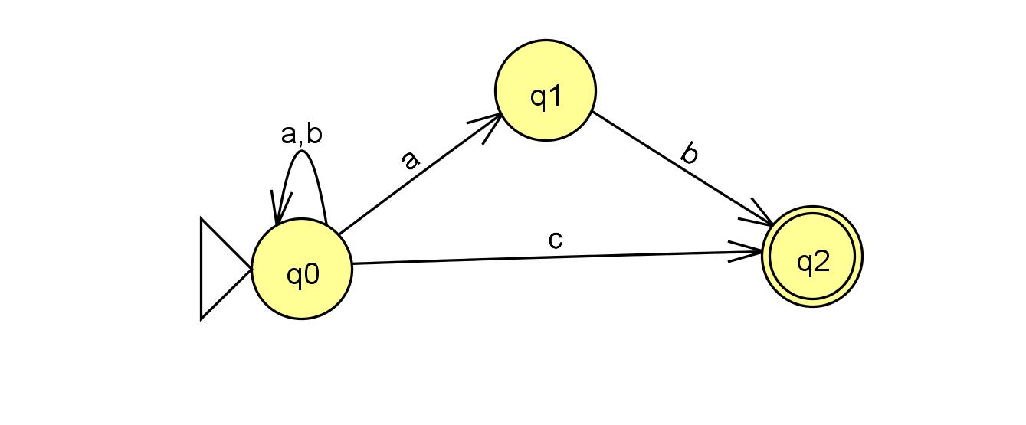
Conversion Example
(Subset Construction)
NFA (N)={Q,∑, δ,q0,F) given with T.G. Convert this NFA to DFA?

Slide 11
Data Given
Q’= { q0, q1, q2 }
Σ’ = {a, b, c}
q0’={q0}
F’={ q2}

Slide 12
Steps of Conversion
For given NFA (N), DFA (D)= (Σ, Q’, q’₀, F’, δ’), we do following steps:
1. Q’=∅
2. Q’={q0}
3. For every state in Q, find the set of states for each input symbol using using N’s transition table, δ. If the set is not Q, add it to Q’.We can start building the transition table δ’ for D by first examining q₀
Q’={ q0,{q0,q1},q2} after consuming symbol a,b,c

Slide 13
Transition Functions δ’
State | a | b | c
q0 | q0,q1 | q0 | q2
State | a | b | c
q0 | { q0,q1} | {q0} | {q2}
q0.q1 | ? | ? | ?
q2 | ? | ? | ?

Slide 14
After union on states{q0,q1}
δ'({q₀, q₁}, a) = δ(q₀,a) ∪ δ(q₁,a) = {q₀, q₁} ∪ ∅ = {q₀, q₁}
δ'({q₀, q₁}, b) = δ(q₀,b) ∪ δ(q₁,b) = c ∪ {q₂} = {q₀, q₂}
δ'({q₀, q₁}, c) = δ(q₀,c) ∪ δ(q₁,c) ={q₂} ∪ ∅ = {q₂}

Slide 15
Update the transition table δ’
The only new state here is {q₀, q₂}.
Q’ = {q₀, {q₀, q₁}, q₂, {q₀, q₂}}
state | a | b | c
q₀ | {q₀, q₁} | q₀ | q₂
{q₀, q₁} | {q₀, q₁} | {q₀, q₂} | q₂
q₂ | ? | ? | ?
{q₀, q₂} | ? | ? | ?

Slide 16
Update the transition table δ’
state | a | b | c
q₀ | {q₀, q₁} | q₀ | q₂
{q₀, q₁} | {q₀, q₁} | {q₀, q₂} | q₂
q₂ | – | – | –
{q₀, q₂} | {q₀, q₁} | q₀ | q₂

Slide 17
DFA
Σ = {a, b}
Q’ = {q₀, {q₀, q₁}, q₂, {q₀, q₂}}
q’₀=q₀
F’ = {q₂, {q₀, q₂}}
state | a | b | c
q₀ | {q₀, q₁} | q₀ | q₂
{q₀, q₁} | {q₀, q₁} | {q₀, q₂} | q₂
q₂ | – | – | –
{q₀, q₂} | {q₀, q₁} | q₀ | q₂

Slide 18
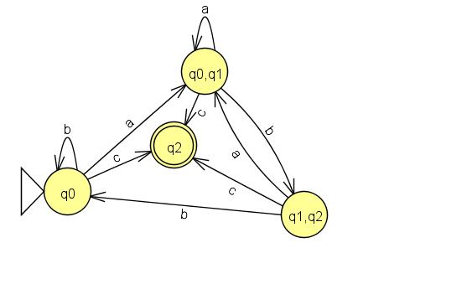
Transition Graph -DFA

Slide 19
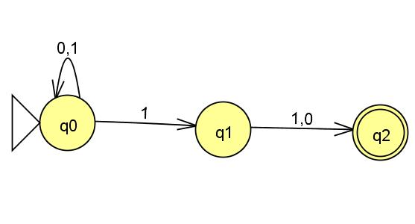
Partition Method
Example 2:
L={w | Second last symbol in w is 1 }

Slide 20
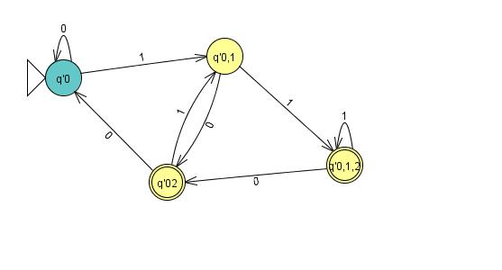
Step By Step

Slide 21
Steps Used
Power Set=2 ^{Q}
Removal of Non reachable state from Start State called Deadlock state
Used Tabular Method
First State is ∅ State

Slide 22
Table Power Set
 | 0 | 1
q0 | q0 | q0 ,q1
q1 | q2 | q2
q2 | - | -
q0q1 | q0 | q0,q1,q2
q1,q2 | q2 | q2
q0,q2 | q0 | q0,q1
q0,q1,q2 | q0,q2 | q0,q1.q2

Slide 23
DFA Construction
 | 0 | 1
q0 | q0 | q0 ,q1
q1 | q2 | q2
q2 | - | -
q0q1 | q0 | q0,q1,q2
q1,q2 | q2 | q2
q0,q2 | q0 | q0,q1
q0,q1,q2 | q0,q2 | q0,q1.q2

Slide 24
Thanking You!!!!!!

